Slide 1

Department of Computer Science And Engineering
UNIVERSITY COLLEGE OF ENGINEERING, SCIENCE AND TECHNOLOGY HYDERABAD
JAWAHARLAL NEHRU TECHNOLOGICAL UNIVERSITY HYDERABAD
Kukatpally, Hyderabad, Telangana (India) - 500 085.
DISSERTATION WORK REVIEW I
Analysing the Performance and Fairness of Machine Learning-based Depression Screening: Using NHANES Data Across the
COVID-19 Period
Presented by:
Kurivella Greeshma (22011P0504)
CSE IDP 5th Year 1st Semester
JNTUH-UCESTH
Guide:
Dr. B. Kranthi Kiran
Professor & Coordinator – SC/ST Cell
JNTUH-UCESTH

Slide 2
ABSTRACT
Existing ML-based studies have primarily focused on identifying depression-related factors and predicting depression within specific time periods. However, the temporal robustness and fairness of these models when applied to populations experiencing changes in health and social conditions remain insufficiently explored. The COVID-19 pandemic provides a clear temporal boundary, as the post-COVID period involved changes in mental health, healthcare access, and behavioural patterns.
This study proposes to evaluate whether ML-based depression screening models trained on pre-pandemic National Health and Nutrition Examination Survey (NHANES) data maintain their performance and fairness when applied to post-pandemic NHANES data without retraining. Model performance will be assessed using F1-score, AUROC, sensitivity, and calibration, while changes in underlying features will be examined to identify temporal distribution shift. Algorithmic fairness will be evaluated across relevant demographic and socioeconomic subgroups using established metrics such as Equal Opportunity and Demographic Parity.
It does not claim that COVID-19 caused model bias; rather, it investigates whether model performance and fairness metrics changed across the pre-/post-COVID period.

Slide 3
BASE PAPER
Base Paper:
Vu T., Dawadi R., Yamamoto M., et al. (2025)
Prediction of depressive disorder using machine learning approaches: findings from the NHANES
Journal: BMC Medical Informatics and Decision Making Year: 2025
Citation:
Vu T, Dawadi R, Yamamoto M, Tay JT, Watanabe N, Kuriya Y, Oya A, Tran PNH, Araki M. Prediction of depressive disorder using machine learning approaches: findings from the NHANES. BMC Med Inform Decis Mak. 2025 Feb 17;25(1):83. doi: 10.1186/s12911-025-02903-1. PMID: 39962516; PMCID: PMC11834192.
The paper uses the publicly available NHANES dataset for predicting the depression levels of the population during the time period of 2013-2014, where it evaluates the performance of six different Machine Learning models.

Slide 4
INTRODUCTION/BACKGROUND
Depression is an important population-level mental health concern.
ML can support depression screening using population health data.
However, the problem here is that, the population characteristics can change over time.
A model trained on one population/time period may not behave the same way on another.
This study proposes to analyse whether the already used ML models-based depression screening, trained on the pre-pandemic NHANES data, remain accurate in predicting performance and fairness when applied to a post-pandemic NHANES dataset, without retraining.
The project focuses on assessing whether the models’ performance and fairness metrics changed, over the pre/post-COVID period.

Slide 5
PROBLEM STATEMENT
“ Can an ML-based depression screening model trained on one population and time period remain reliable and fair when applied to a later population whose characteristics have changed? “
This study aims to evaluate machine learning-based depression screening models trained on pre-COVID NHANES data when applied to post-COVID NHANES data without retraining.
The study will compare model performance, changes in feature distributions, and fairness across selected demographic and socioeconomic subgroups.

Slide 6
OBJECTIVES
Evaluate predictive performance of pre-COVID trained ML models on post-COVID NHANES data.
Compare model performance across the pre-COVID and post-COVID periods using metrics such as AUROC, F1-score, Sensitivity, and Calibration.
Analyse temporal distribution shift by examining changes in the underlying demographic, socioeconomic, behavioural, and health-related features.
Assess algorithmic fairness across selected demographic and socioeconomic subgroups using Equal Opportunity and Demographic Parity.
Determine the importance of temporal monitoring for ML-based mental health screening models when population characteristics change over time.

Slide 7
LITERATURE REVIEW
Study / Year | Focus | Limitations/Gap identified
Vu et al. (2025) | ML-based depression prediction using NHANES | Focuses on depression prediction using NHANES data; temporal robustness and fairness across changing populations are not the primary focus. This creates an opportunity to evaluate model behaviour across different time periods.
NHANES-based depression studies | Depression determinants & prediction | Predominantly evaluate determinants and prediction within specific time periods. Limited investigation of how model performance changes when applied to a later population
ML fairness studies | Fairness in healthcare ML | Fairness is often evaluated as a static property; less attention is given to how fairness may change when the underlying population/data distribution changes over time.
Temporal / distribution-shift studies | ML performance under changing populations | Temporal performance is often studied separately from algorithmic fairness. The combined effect of temporal distribution shift on performance and fairness in depression screening remains less explored.
COVID-era mental-health research | Changes in mental health, behaviour & healthcare access | Provides evidence of population-level change, but does not necessarily evaluate whether pre-existing ML depression-screening models remain reliable and fair when transferred to post-COVID populations.

Slide 8
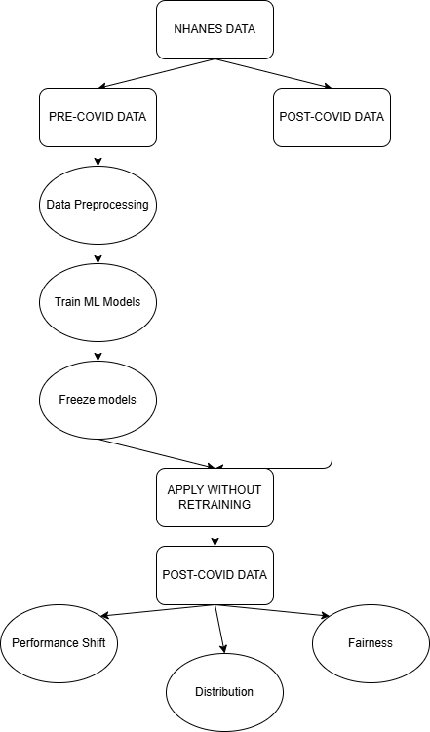
PROPOSED METHODOLOGY/ WORKING PROCESS

Slide 9
TECHNOLOGY STACK
Programming Language: Python
Data Processing & Analysis: Pandas (data loading, cleaning and manipulation), NumPy (numerical operations), SciPy (statistical analysis / distribution comparison), Matplotlib / Seaborn (visualisation).
Machine Learning: Scikit-learn (model development and evaluation), ML classification models for depression screening.
Dataset: NHANES (National Health and Nutrition Examination Survey) , .XPT / SAS transport files.
Fairness & Model Analysis: Fairlearn (subgroup fairness evaluation), Scikit-learn (performance metrics and calibration), Statistical methods for distribution-shift analysis.
Development Environment: Jupyter Notebook / Google Colab , Git / GitHub for version control.

Slide 10
MACHINE LEARNING ALGORITHMS
Model | Purpose
Logistic Regression | Interpretable baseline for binary depression prediction
Random Forest | Non-linear ensemble model for tabular health data
XGBoost | Gradient-boosting model for capturing complex feature relationships

Slide 11

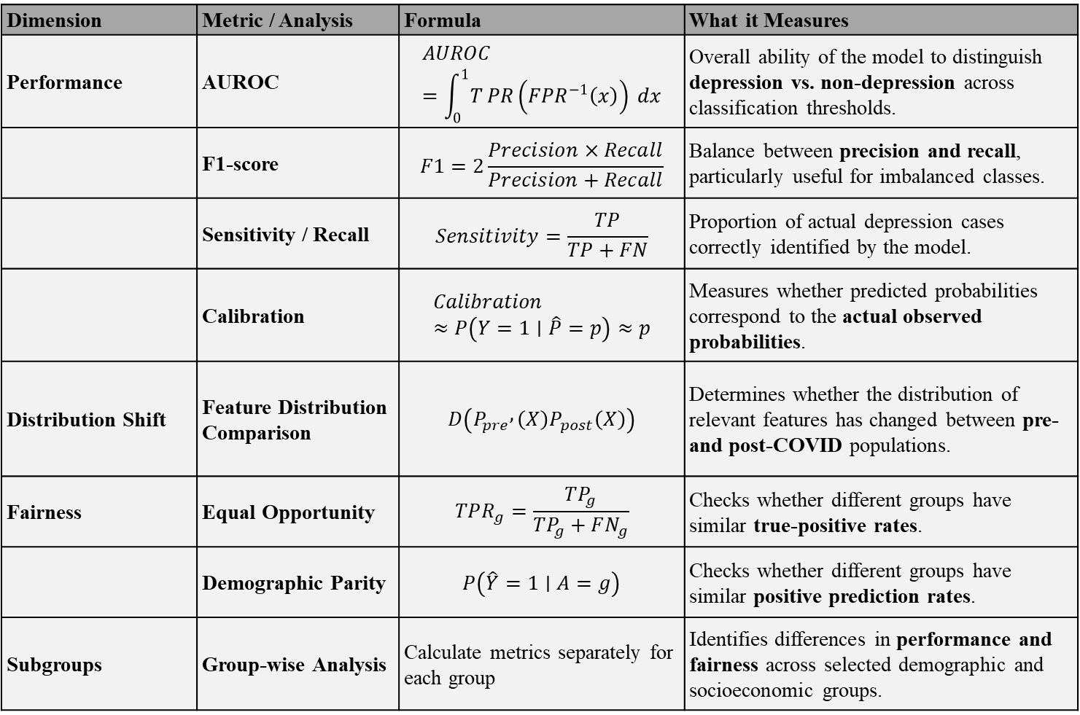
EVALUATION METRICS
Dimension | Metric / Analysis | Formula | What it Measures
Performance | AUROC | $$AUROC=\int_{0}^{1}{T}PR\left(FPR^{−1}\left(x\right)\right) dx$$ | Overall ability of the model to distinguish depression vs. non-depression across classification thresholds.
 | F1-score | $$F1=2\frac{Precision×Recall}{Precision+Recall}$$ | Balance between precision and recall, particularly useful for imbalanced classes.
 | Sensitivity / Recall | $$Sensitivity=\frac{TP}{TP+FN}$$ | Proportion of actual depression cases correctly identified by the model.
 | Calibration | $$Calibration≈P\left(Y=1∣\hat{P}=p\right)≈p$$ | Measures whether predicted probabilities correspond to the actual observed probabilities.
Distribution Shift | Feature Distribution Comparison | $$D\left(P_{pre} , \left(X\right)P_{post}\left(X\right)\right)$$ | Determines whether the distribution of relevant features has changed between pre- and post-COVID populations.
Fairness | Equal Opportunity | $$TPR_{g}=\frac{TP_{g}}{TP_{g}+FN_{g}}$$ | Checks whether different groups have similar true-positive rates.
 | Demographic Parity | $$P\left(\hat{Y}=1∣A=g\right)$$ | Checks whether different groups have similar positive prediction rates.
Subgroups | Group-wise Analysis | Calculate metrics separately for each group | Identifies differences in performance and fairness across selected demographic and socioeconomic groups.
Where:
TP = True Positive
TN = True Negative
FP = False Positive
FN = False Negative
TPR = True Positive Rate
FPR = False Positive Rate
A = Protected/group attribute
$g$= A particular demographic or socioeconomic group
P = probability
Y = 1 – the actual outcome is positive ( i.e. the person has depression)

Slide 12
EXPECTED CONTRIBUTION
Temporal Robustness: Determine whether predictive performance changes across periods.
Distribution Shift: Identify changes in relevant population features.
Fairness Drift: Investigate whether fairness metrics change across subgroups.
Practical Insight: Highlight the need for temporal monitoring of ML-based mental health screening.
What the study does NOT claim
COVID caused model bias
All possible fairness metrics are covered
All depression determinants are analysed
Causal relationships are established

Slide 13
CONCLUSION
This study proposes to investigate the temporal robustness and fairness of ML-based depression screening models using NHANES data across the COVID-19 period.
ML models will be trained on pre-COVID NHANES data and evaluated on post-COVID data without retraining.
Model behaviour will be assessed through three key dimensions: predictive performance, temporal distribution shift, and algorithmic fairness.
Performance will be evaluated using AUROC, F1-score, sensitivity and calibration, while fairness will be assessed using Equal Opportunity and Demographic Parity.
The study aims to determine whether model performance and fairness remain stable when population characteristics change over time.
The findings can highlight the importance of continuous temporal monitoring of ML-based mental-health screening models before applying them to changing populations.

Slide 14
REFERENCES
[1] T. Vu, R. Dawadi, M. Yamamoto, J. T. Tay, N. Watanabe, Y. Kuriya, A. Oya, P. N. H. Tran, and M. Araki, “Prediction of depressive disorder using machine learning approaches: findings from the NHANES,” BMC Medical Informatics and Decision Making, vol. 25, no. 1, Art. no. 83, 2025, doi: 10.1186/s12911-025-02903-1.
[2] Centers for Disease Control and Prevention, “National Health and Nutrition Examination Survey (NHANES).” [Online]. Available: https://www.cdc.gov/nchs/nhanes/.
[3] H. Weerts, M. Dudík, R. Edgar, A. Jalali, R. Lutz, and M. Madaio, “Fairlearn: Assessing and improving fairness of AI systems,” Journal of Machine Learning Research, 2023.
[4] N. Mehrabi, F. Morstatter, N. Saxena, K. Lerman, and A. Galstyan, “A survey on bias and fairness in machine learning,” ACM Computing Surveys, vol. 54, no. 6, pp. 1–35, 2021, doi: 10.1145/3457607.
[5] S. Barocas, M. Hardt, and A. Narayanan, Fairness and Machine Learning. 2019. [Online]. Available: https://fairmlbook.org/.

Slide 15
THANK YOU

